Slide 1
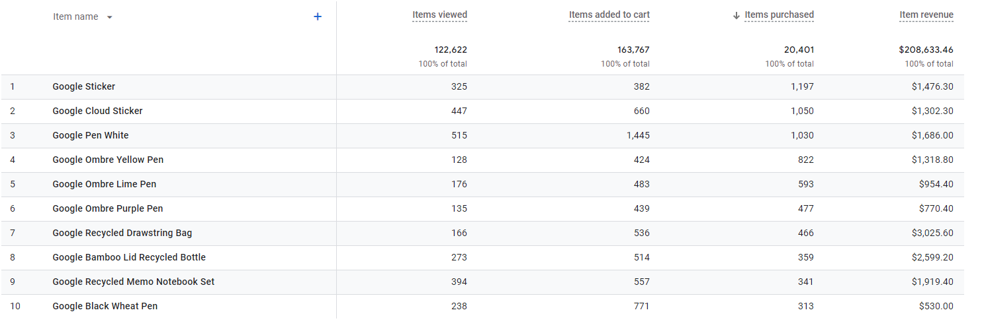
When looking at sales volume we can clearly see that Stickers and Pens are the winners here, but before deciding if we can consider this our “top selling” product we need to check the item revenue
2024 Jan 1st - Mar 301st

Slide 2
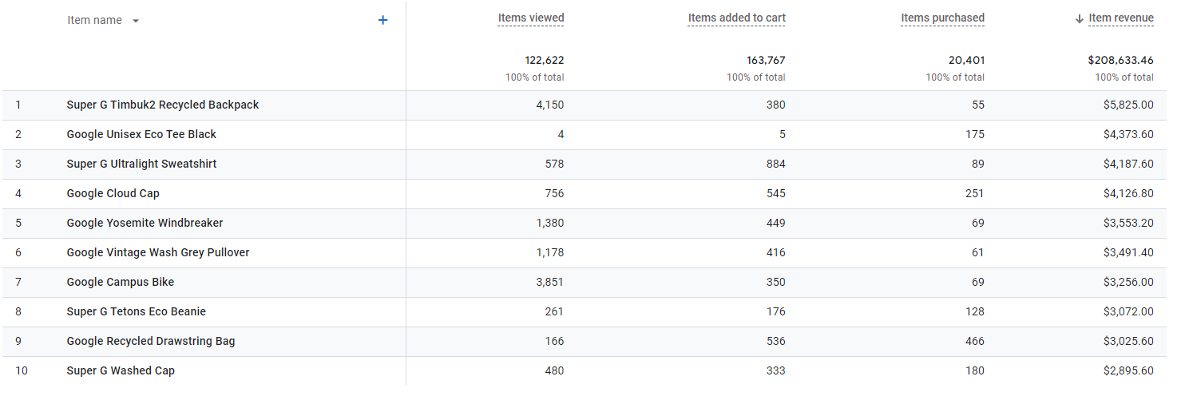
Now that we filtered the purchases by revenue we can see that the actual winners, bringing us revenue are clothes, backpacks and bags. 377/460 products sold at least once, so we can take some budget from the items that are not selling well and double down on the ones that are bringing revenue
2024 Jan 1st - Mar 1st

Slide 3
The data we are analyzing is 2024 Jan 1st - Mar 1st. Keeping that in mind, summer is coming, we can narrow down some product lines. For example from this Top10 list, we can exclude Sweatshirt, Pullover, Beanie - as they are less relevant in summer, that leaves us with 7 items that we can advertise even more aggressively.

Slide 4
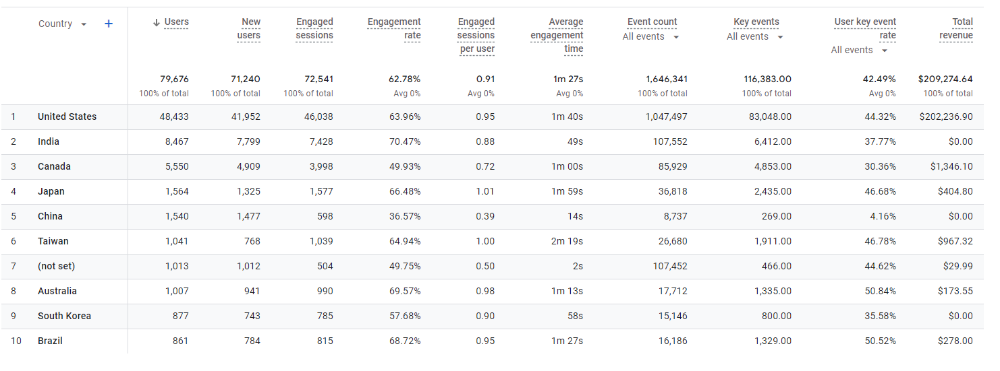
Based on the demographics of our users it may seem that India is worth expanding to, but then we see that out of these 8467 users we didn’t get any sales. Taiwan has only 1041 users, yet they spent ~$970, so we might consider this option in the near future.
Canada (5550 users) - it’s going to be way easier and cheaper to expand there, since we don’t need to translate the site or product pages, as Canadians speak english as well. While we expand to Canada and get additional revenue we might address the issue of why Indian users are not converting at all.
Canada is a big market with big spenders, so we don’t want to miss opportunity to scale there, before heading to Asian countries.

Slide 5
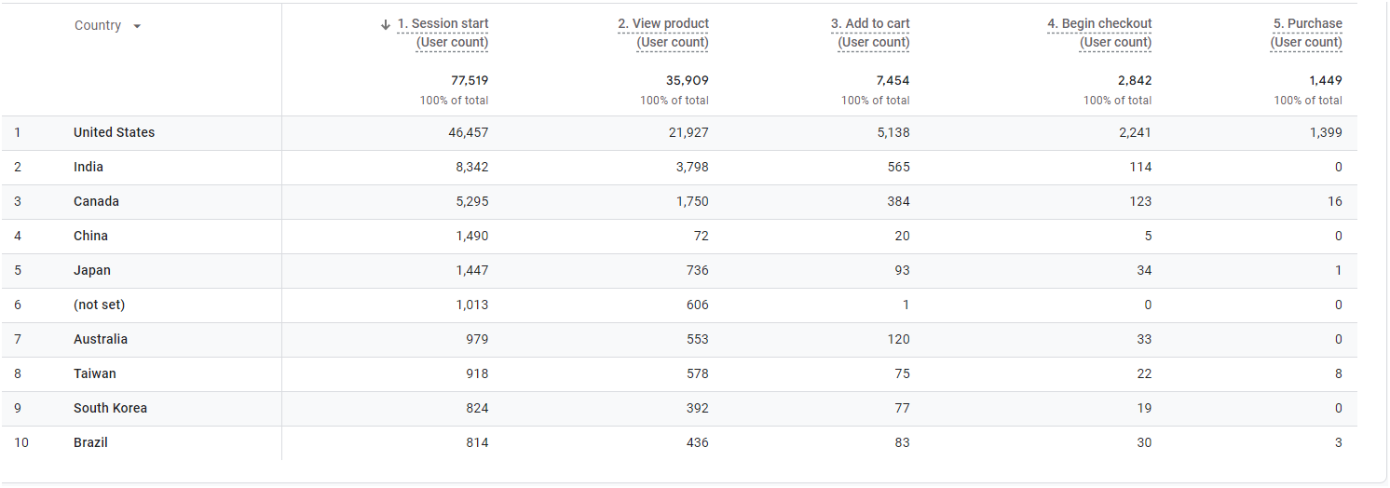
If we analyze why India is not performing, we can see that we had 565 add to carts from 8342 users (6,8%), compared to USA add to cart ratio of 11%. So yes it’s a lot lower, yet 0 purchases, that might indicate we have our shipping set up wrong, maybe payment methods are not available in India or other factors in the checkout process that might be preventing customers from India to purchase our products.

Slide 6
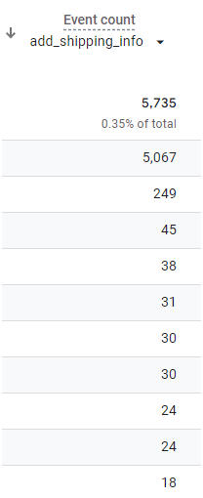
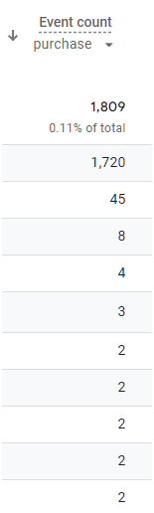
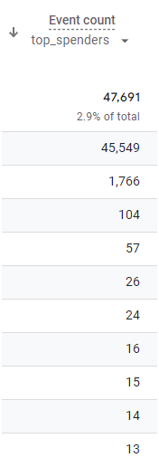
Even when we check other key events, we see Canada is 2nd after the US, that just reassures we should expand to Canada before any other market
USA
USA
Not Set
Canada
Canada
USA
Canada

Slide 7
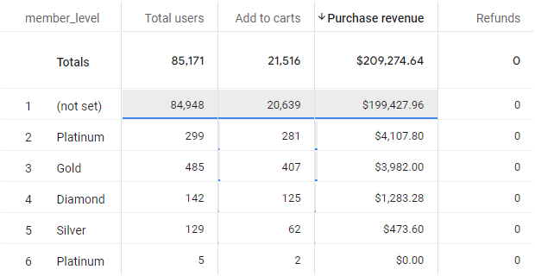
We can see that roughly only 1000 Google Play members out of 85000 have some kind of a level (~1,2%), yet those members bring $10 000 revenue out of total $209 000 (~4,8%).
Revenue
per member:
$2,3
$13,7
$8,2
$9
$3,7
Revenue
Per user
Users
Revenue
Non-Members: 84948 $199 428 $2,3
Members: 1060 $9847 $9,3

Slide 8
Based on the numbers we can clearly see that the higher the level - the higher the revenue, so if we are making profit here, we should pay more attention to these levels and try acquire more members here.
Platinum members tend to spend more than Diamond, so we need some changes as that’s not logical or simply combine some levels and leave them at “Silver” “Gold” “Diamond”
Since we clearly see that members spend more than the ones without membership ($9,3 compared to $2,3), we need to continue this program, yet it needs some changes to engage people more and get them the membership.

